Slide 1
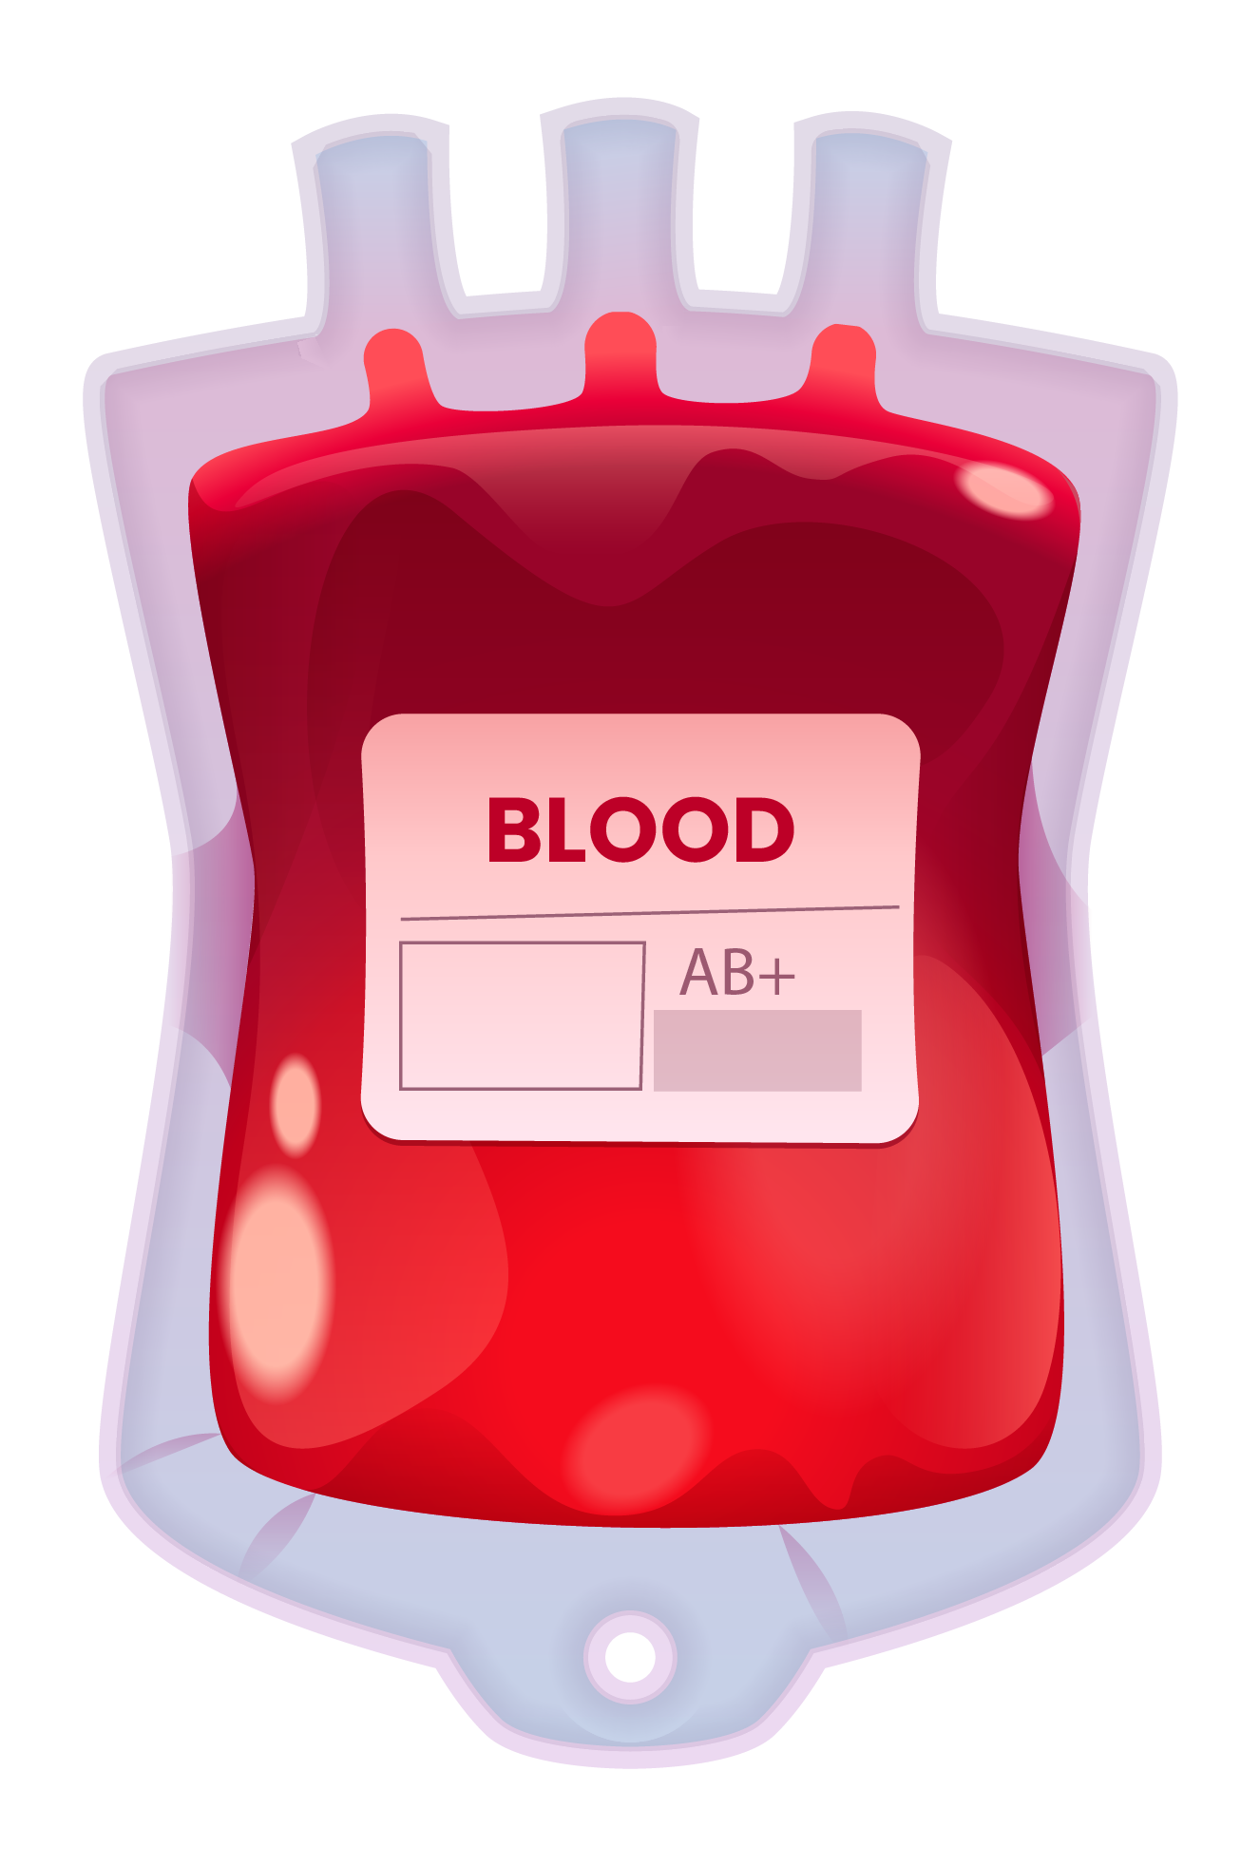
BLOOD BANK
Group 1
Sukhveer Singh
Karthik Vadlamani

Slide 2


TABLE OF CONTENTS
01
02
Introduction
Business Model
Extendend Enitity Relation Diagram
04
05
06
Unified Modeling Language Diagram
Visualizations
Normalized Relational Model
03

Slide 3
INTRODUCTION
Blood Bank provides services for the people who need blood by getting help from hospitals who are interested in donating blood for people. The People who need blood registers in my site as as receiver and hospitals will register as donor. The inspiration of this project is to develop a blood bank information system, which focuses on making an online system that is accessible to both hospitals and receivers. Our Life is so busy that we don’t have time to spend going here and there and also this is also much more accessible in case of Emergencies.

Slide 4






Business Model
The website allows a person or a hospital to obtain blood easily via this website.
The Website contains 2 types of users Hospital and Receivers.
The People who need blood registers in my site as receiver and hospitals will register as donor.
The inspiration of this project is to develop a blood bank information system, which focuses on making an online system that is accessible to both hospitals and receivers.
The main benefit of this system is the information available blood group.

Slide 5
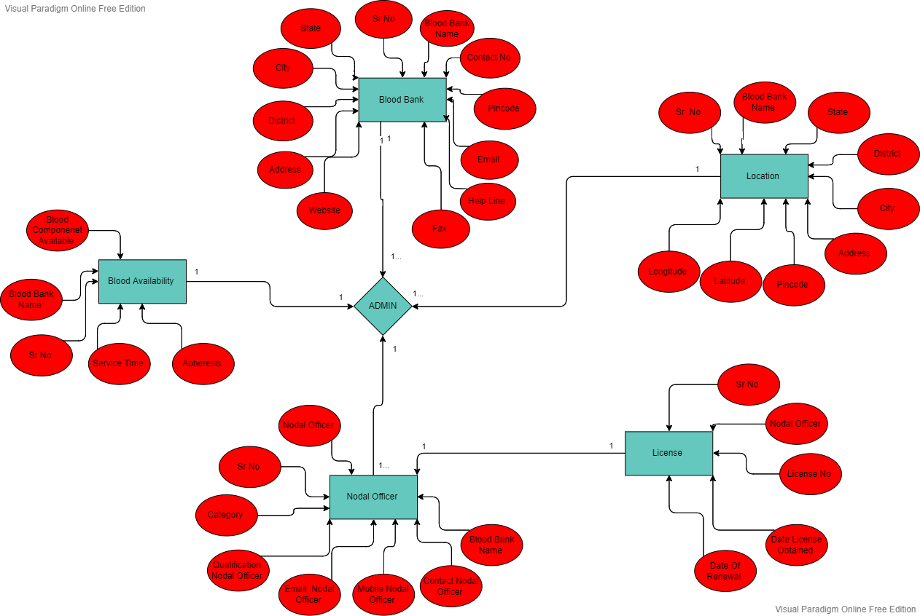
Extended Entity Relation Diagram

Slide 6
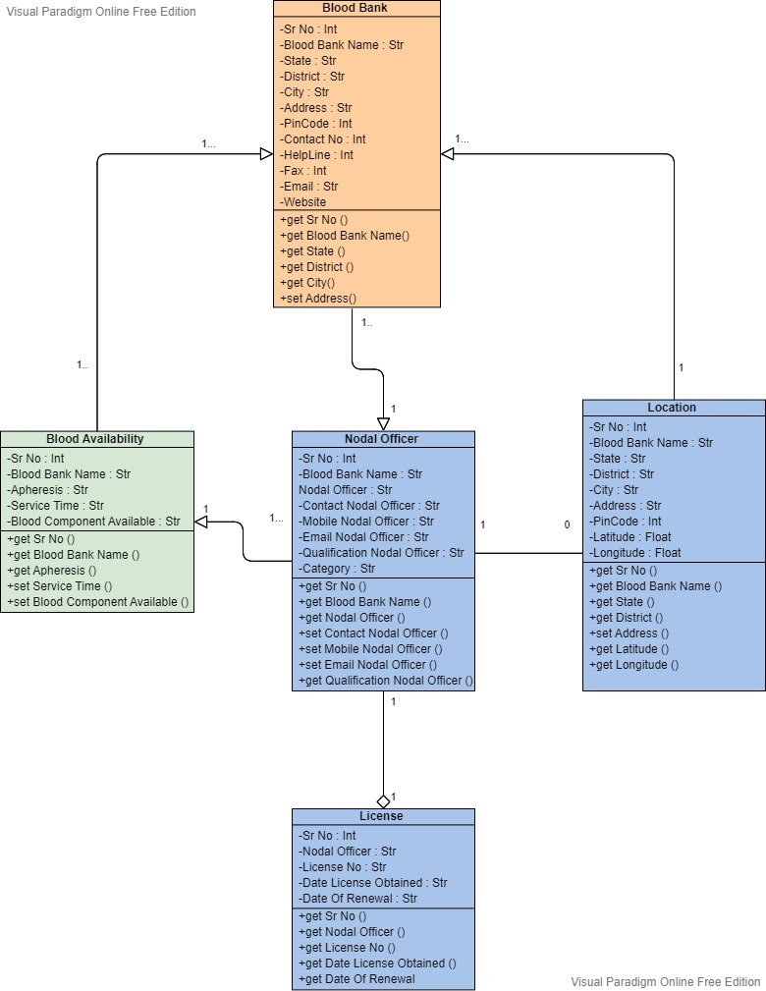
Unified Model Language Diagram

Slide 7
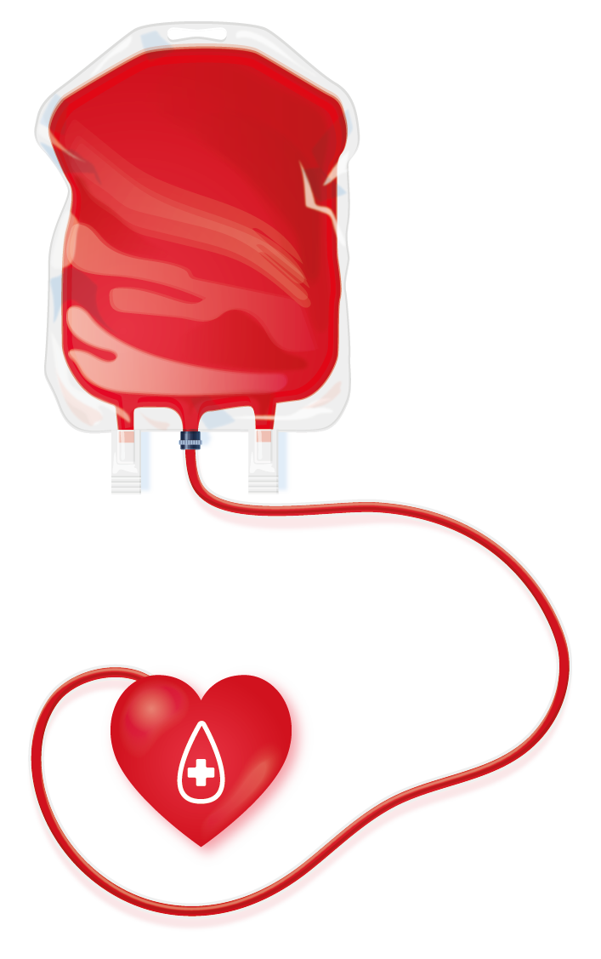
Normalized Relational Model
Primary Key | Foreign Key
Blood Bank : Blood Bank Name, Contact No, Mobile No, Helpline, Fax, Email, Website
Nodal Officer : Blood Bank Name, Nodal Officer Name, Contact No, Mobile Number, Email, Qualification, Category
Blood Availability : Blood Bank Name, Apheresis, Service time, Component Available
License : Nodal Officer Name, License No, Date Obtained, Date Of Renewal
Location : Blood Bank Name, State, District, City, Address, Pincode

Slide 8
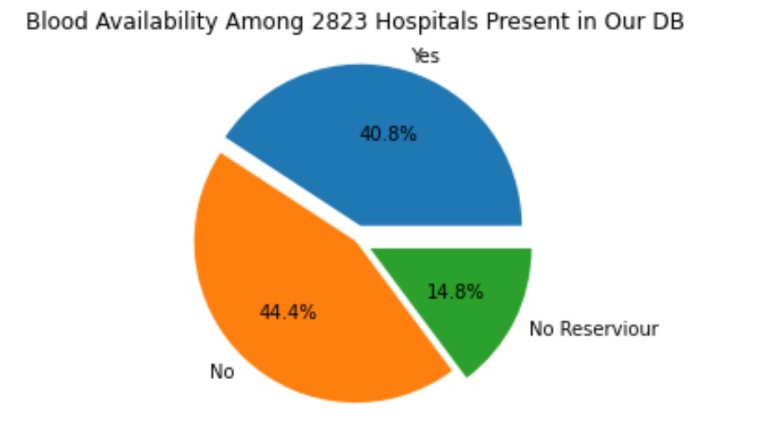
OUR STATISTICS
40.8%
YES
No of Hospitals have blood available
NO
44.4%
No of Hospitals Do not have blood available
14.8%
NO RESERVOIR
No of Hospitals having no blood reservoir

Slide 9

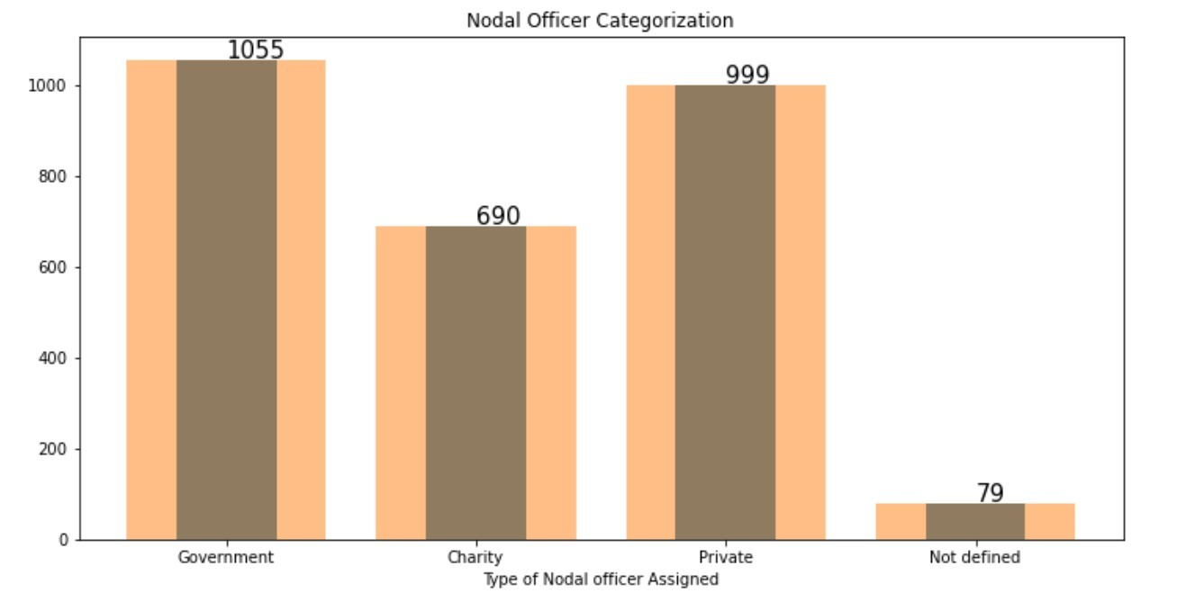


Nodal Officer Categorization

Slide 10
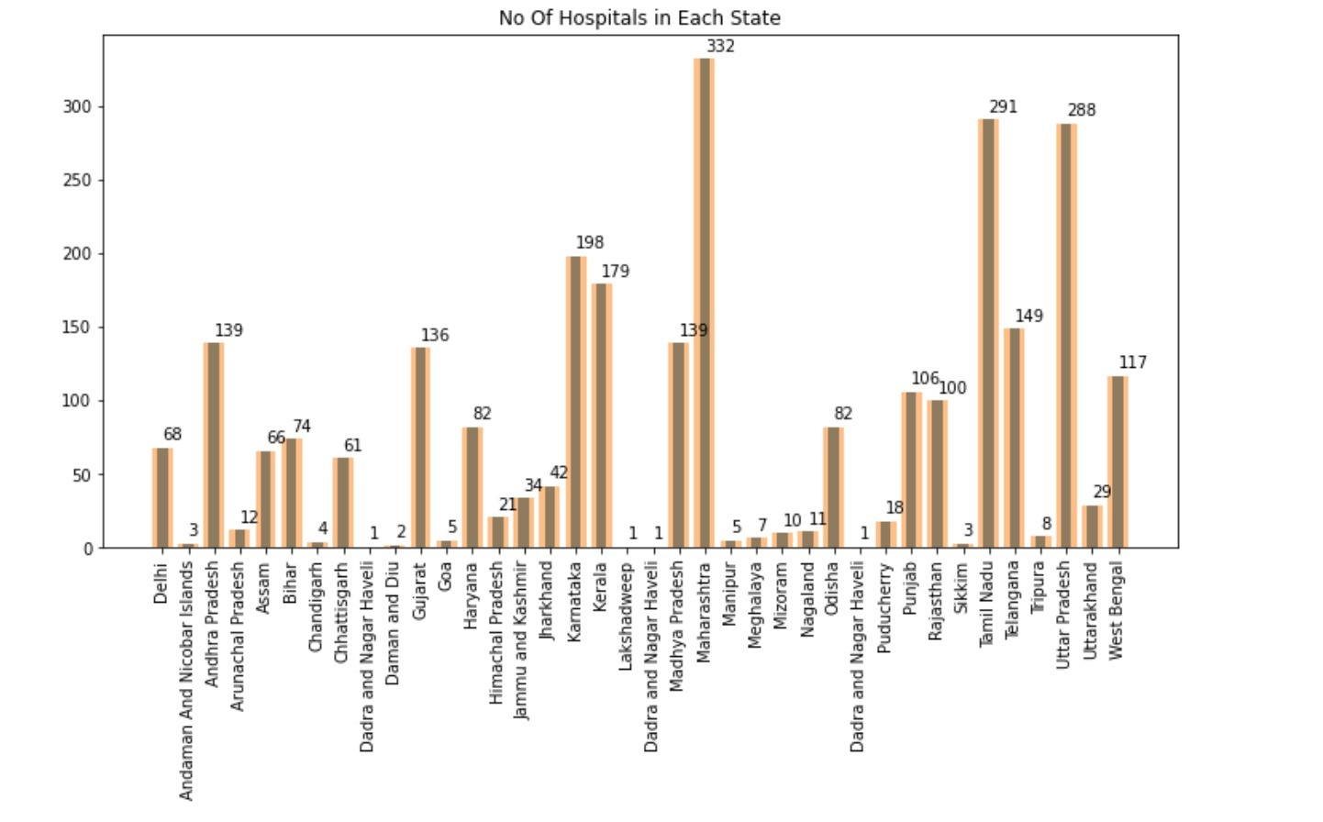

No: of Hospitals in Each state

Slide 11
Thanks!!
Sukhveer Singh
Karthik Vadlamani

